Slide 1
CS 211 Computer Architecture Lecture 40: Virtual Memory – 2 Paged Memory
Ravi Mittal
ravi.mittal@iitgoa.ac.in
Indian Institute of Technology, Goa

Slide 2
We will study today ..
Virtual Memory Concepts (Revision)
Paged Memory
Page Hit, Page Fault, Demand Paging
Page Table Location, Kernel Page Table
Summary

Slide 3
Acknowledgements
Krste Asanović & Randy H. Katz, CS 61C: Great Ideas in Computer Architecture (Machine Structures), http://inst.eecs.berkeley.edu/~cs61c/
Chapter 6, Memory Hierarchy, Book: Computer Systems: A programmer’s perspective, Randal E. Bryant and David R. O’Hallaron
Prof Onur Mutlu’s Class Presentation, ETH Zürich, Lecture 21b: Memory Hierarchy and Caches, Sprint 2020
Patterson and Hennessy, Book: Computer Organization and Design, Hardware/Software Interface, RISC-V Edition
MIT 6.004 Spring 2020, Class on Caches
Digital Design and Computer Architecture: RISC-V Edition, Harris & Harris Elsevier

Slide 4
Virtual Memory - Concepts (Last class)

Slide 5
A System Using Physical Addressing
Physical (Main) memory
0:
1:
Physical address
(PA)
2:
CPU
3:
4
4:
5:
6:
7:
8:
...
M-1:
Data word
Used in “simple” systems like embedded microcontrollers in devices like cars, elevators, and digital picture frames
This is not the way most systems work: Desktop, Mobile etc
Notes:
The main memory of a computer system is organized as an array of M contiguous byte-size cells. Each byte has a unique physical address (PA).

Slide 6
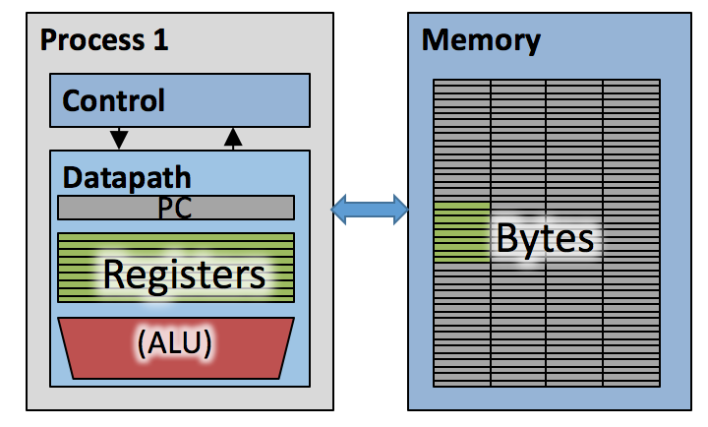
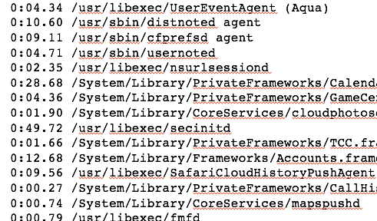
Today’s computers
100+ Processes, managed by OS
100’s of processes
OS multiplexes these over available cores
But what about memory?
There is only one!
We cannot just ”save” its contents in a context switch …
Ref: Krste Asanović & Randy H. Katz, Univ of California, Berkeley

Slide 7
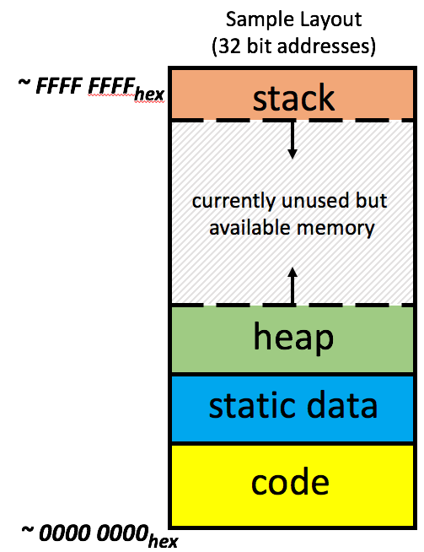
Each process has it’s own (virtual) address space
Process 1
Process 2
Process n

Slide 8
Virtual vs. Physical Addresses
Memory manager
Processor (& Caches)
?
Memory (DRAM)
Control
Datapath
Virtual Address
PC
Physical Address
Bytes
Registers
(ALU)
Many of these (software & hardware cores)
One main memory
Each Process uses it’s own address space
Processes use virtual addresses, e.g., 0 … 0xffff,ffff
Many processes, all using same (conflicting) addresses
Memory uses physical addresses (also, e.g., 0 ... 0xffff,ffff)
Memory manager maps virtual to physical addresses

Slide 9
Review: What is Paged VM?
Divide virtual memory and physical memory into equally sized segments called pages:
0
1
2
3
4
5
6
7
Virtual Memory
0
1
2
3
Physical Memory
Ref: Morgan Rae Reschenberg, Course 61C, Univ of California, Berkeley

Slide 10
Review: What is Paged VM?
Each process has its own virtual memory, but all processes must share physical memory
0
1
2
3
4
5
6
7
Virtual Memory (A)
0
1
2
3
4
5
6
7
Virtual Memory (B)
0
1
2
3
Physical Memory
Ref: Morgan Rae Reschenberg, Course 61C, Univ of California, Berkeley

Slide 11
Review: What is Paged VM?
Pages in physical memory correspond to pages in virtual memory
0
1
2
3
4
5
6
7
Virtual Memory (A)
0
1
2
3
4
5
6
7
Virtual Memory (B)
0
1
2
3
Physical Memory
Ref: Morgan Rae Reschenberg, Course 61C, Univ of California, Berkeley

Slide 12
Review: What is Paged VM?
Each process has a table mapping its physical/virtual pages
0
1
2
3
4
5
6
7
Virtual Memory (A)
VPN | PPN | Valid
0 | X | 0
1 | X | 0
2 | 0 | 1
3 | 2 | 1
4 | X | 0
5 | X | 0
6 | X | 0
7 | 3 | 1
0
1
2
3
Physical Memory
Ref: Morgan Rae Reschenberg, Course 61C, Univ of California, Berkeley

Slide 13
Review: What is Paged VM?
When a process needs more data, the oldest (LRU) page is removed from PM and replaced with a new page from disk
0
1
2
3
4
5
6
7
Virtual Memory (A)
0
1
2
3
4
5
6
7
Virtual Memory (B)
0
1
2
3
Physical Memory
Ref: Morgan Rae Reschenberg, Course 61C, Univ of California, Berkeley

Slide 14
Review: What is Paged VM?
When a process needs more data, its oldest (LRU) page is removed from PM and replaced with a new page from disk
0
1
2
3
4
5
6
7
Virtual Memory (A)
0
1
2
3
4
5
6
7
Virtual Memory (B)
0
1
2
3
Physical Memory
Ref: Morgan Rae Reschenberg, Course 61C, Univ of California, Berkeley

Slide 15
Review: What is Paged VM?
When a process needs more data, its oldest (LRU) page is removed from PM and replaced with a new page from disk
0
1
2
3
4
5
6
7
Virtual Memory (A)
0
1
2
3
4
5
6
7
Virtual Memory (B)
0
1
2
3
Physical Memory
Ref: Morgan Rae Reschenberg, Course 61C, Univ of California, Berkeley

Slide 16
Paged Memory
Today “paged memory” dominates
We call main memory (incl Caches) as physical memory
Physical memory (DRAM) is broken into fixed size blocks called pages (also called frames)
Typical page size: 4 KB
Processes use Virtual Address
Virtual address space divided into pages
Interpret each N-bit virtual address as a pair:
<virtual page number, offset>
Virtual address (e.g., 32 Bits)
Virtual page number (e.g., 20 Bits) | offset (e.g., 12 Bits)

Slide 17
Modern Virtual Memory Systems Illusion of a large, private, uniform store
Protection
Several programs, each with their private address space and one or more shared address spaces
Demand Paging
Provides the ability to run programs larger than the primary memory
Hides differences in machine configurations
The price is address translation on
each memory reference
OS
prog_{i}
Swapping
Store
Primary
Memory
VA
mapping
PA
TLB
Ref: Morgan Rae Reschenberg, Course 61C, Univ of California, Berkeley
Notes:
Portability on machines with different memory configurations.

Slide 18
Paged Memory

Slide 19
Virtual Pages
A virtual page is mapped to
A physical page in physical memory, if the virtual page is in physical memory
A page in disk, otherwise

Slide 20
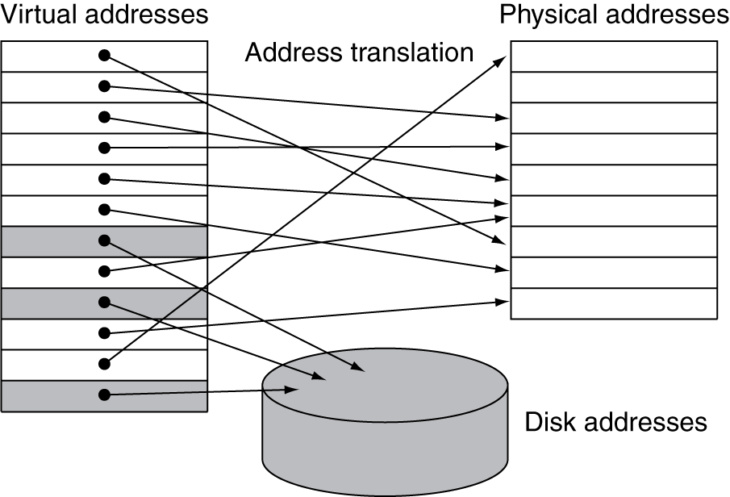
Paged Memory for a process

Slide 21
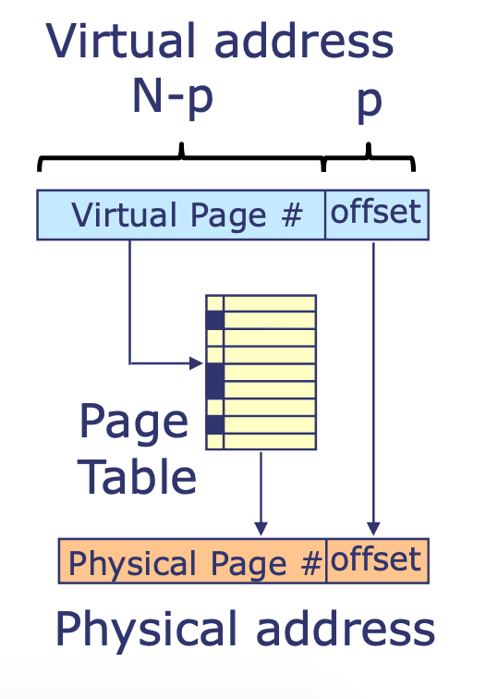
Page Table
Page table is the table that stores the mapping of virtual pages to physical pages
Page table contains the physical page number (i.e., starting physical address) for each virtual page number
Note: N=32 in RISC-V system we have seen so far but other values are common
Must fit within address registers but processor or OS can limit it further (e.g., x86-64 uses 48-bit VA)

Slide 22
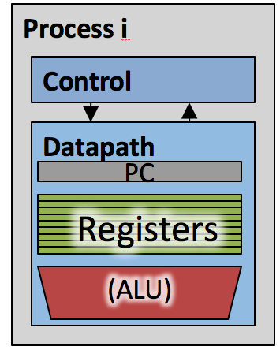
Each Process has a page table
Memory (DRAM)
Page Table
Page N
Page 2
Page 1
Page 0
Page Table
Page Table
Each process has a dedicated page table. Physical memory non-consecutive.

Slide 23
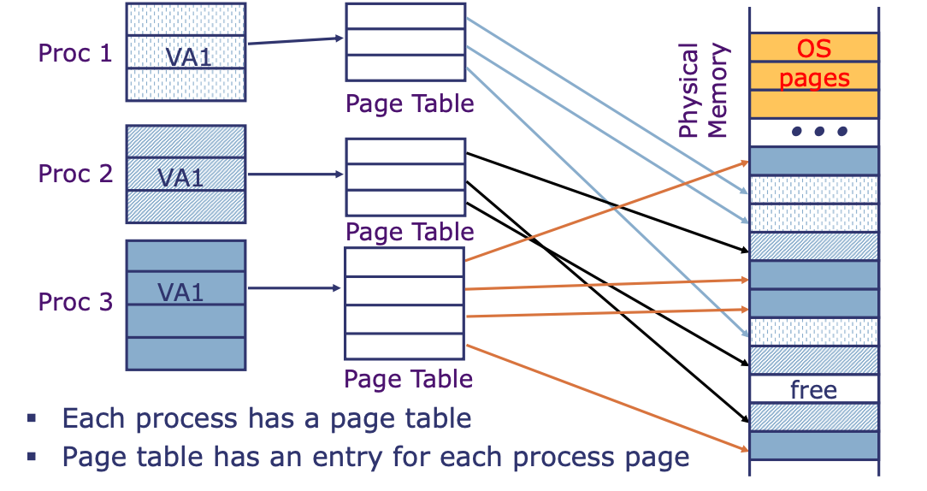
Each Process has a page table
Page table makes is possible to store the pages of a program non-contiguously

Slide 24
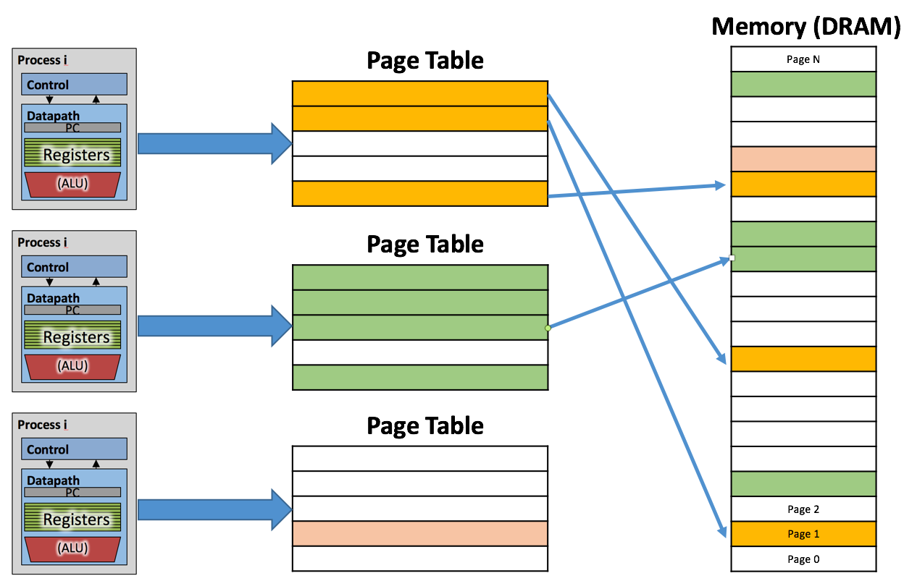
Paged Memory Address Translation
OS keeps track of which process is active
Chooses correct page table
Memory manager extracts page number from virtual address
Looks up page address in page table
Computes physical memory address from sum of
Page address and
Offset (from virtual address)
Virtual address (e.g. 32 Bits)
Virtual Page Number | offset
Physical address
Physical Page Number | offset
Physical addresses may (but do not have to) have more or fewer bits than virtual addresses

Slide 25
Virtual to Physical Address
Virtual Address
Virtual Page Number
Offset
Page table lookup!
Physical Page Number
Offset
Physical Address
Ref: Morgan Rae Reschenberg, Course 61C, Univ of California, Berkeley

Slide 26
Virtual Page not in Physical Memory?
Then it must exist on Disk
Virtual memory system brings the page from disk into a page in physical memory
Updates mapping in the page table

Slide 27
Virtual Pages on Disk
At any time, the set of virtual pages on disk is partitioned into three disjoint subsets:
Unallocated: Pages that have not yet been allocated (or created) by the VM system. Unallocated blocks do not have any data associated with them, and thus do not occupy any space on disk
Cached: Allocated pages that are currently cached in physical memory.
Uncached: Allocated pages that are not cached in physical memory. They are available in Disk Memory
Disk memory
Physical memory
VP 0
Unallocated
0
VP 1
Cached
0
Empty
PP 0
Uncached
PP 1
Unallocated
Empty
Cached
Uncached
Empty
Cached
M-1
PP 2^{m-p}-1
VP 2^{n-p}-1
Uncached
N-1
Virtual pages (VPs)
stored on disk
Physical pages (PPs)
cached in DRAM
Adapted from Bryant and O’Hallaron, Computer Systems: A Programmer’s Perspective, Third Edition
Notes:
Virtual Pages are numbered VP0, VP1, … VP 2^{n-p} - 1

Slide 28
Page Table on Physical Memory
A page table is an array of page table entries (PTEs) that maps virtual pages to physical pages.
For every process there is a page table in Main Memory (DRAM)
Physical memory
(DRAM)
Physical page
number or
disk address
Valid
VP 1
PP 0
PTE 0
0
null
VP 2
1
VP 7
VP 4
PP 3
1
0
1
0
null
Disk memory
0
PTE 7
1
VP 1
Memory resident
page table
(DRAM)
VP 2
VP 3
VP 4
VP 6
Adapted from Bryant and O’Hallaron, Computer Systems: A Programmer’s Perspective, Third Edition
VP 7

Slide 29
Note
Each page in the virtual address space has a PTE at a fixed offset in the page table
Each PTE consists of a valid bit and an n-bit address field
The valid bit indicates whether the virtual page is currently cached in DRAM
If the valid bit is set, the address field indicates the start of the corresponding physical page in DRAM where the virtual page is cached
Valid bit is not set:
Null address indicates that the virtual page has not been allocated
Non-null address points to the start of virtual page on disk
Any physical page can contain any virtual page (fully associative)

Slide 30
Page Hit, Page Fault, Demand Paging

Slide 31
Page Hit
Page hit: reference to VM word that is in physical memory (DRAM cache hit)
Physical memory
(DRAM)
Physical page
number or
disk address
VPN Offset
Valid
VP 1
PP 0
PTE 0
0
null
VP 2
1
VP 7
VP 4
PP 3
1
0
1
0
null
Virtual memory
(disk)
0
PTE 7
1
VP 1
Memory resident
page table
(DRAM)
VP 2
VP 3
Page Not hit: PTE refers to location in swap space on disk
VP 4
VP 6
VP 7
Adapted from Bryant and O’Hallaron, Computer Systems: A Programmer’s Perspective, Third Edition

Slide 32
Page Fault
Page fault: reference to VM word that is not in physical memory (DRAM cache miss)
Physical memory
(DRAM)
Physical page
number or
disk address
VPN Offset
Valid
VP 1
PP 0
PTE 0
0
null
VP 2
1
VP 7
VP 4
PP 3
1
0
1
0
null
Disk memory
0
PTE 7
1
VP 1
Memory resident
page table
(DRAM)
VP 2
VP 3
VP 4
VP 6
VP 7
Adapted from Bryant and O’Hallaron, Computer Systems: A Programmer’s Perspective, Third Edition

Slide 33
Handling Page Fault (1/3)
Page miss causes page fault (an exception)
Virtual address
Physical memory
(DRAM)
Physical page
number or
disk address
VPN Offset
Valid
VP 1
PP 0
PTE 0
0
null
VP 2
1
VP 7
VP 4
PP 3
1
0
1
0
null
Virtual memory
(disk)
0
PTE 7
1
VP 1
page table
Memory resident
(DRAM)
VP 2
VP 3
VP 4
VP 6
VP 7
Adapted from Bryant and O’Hallaron, Computer Systems: A Programmer’s Perspective, Third Edition

Slide 34
Handling Page Fault (2/3)
Page fault handler selects a victim to be evicted (here VP4 – see previous page)
Uses some page replacement policy such as LRU
Brings in VP3 from Disk to Physical Memory
Virtual address
Physical memory
(DRAM)
Physical page
number or
disk address
VPN Offset
Valid
VP 1
PP 0
PTE 0
0
null
VP 2
1
VP 7
VP 3
PP 3
1
1
0
0
null
Virtual memory
(disk)
0
PTE 7
1
VP 1
Memory resident
page table
(DRAM)
VP 2
VP 3
VP 4
VP 6
VP 7
Adapted from Bryant and O’Hallaron, Computer Systems: A Programmer’s Perspective, Third Edition

Slide 35
Handling Page Fault (3/3)
Offending instruction is restarted: page hit!
Virtual address
Physical memory
(DRAM)
Physical page
number or
disk address
VPN Offset
Valid
VP 1
PP 0
PTE 0
0
null
VP 2
1
VP 7
VP 3
PP 3
1
1
0
0
null
Virtual memory
(disk)
0
PTE 7
1
VP 1
Memory resident
page table
(DRAM)
VP 2
VP 3
Key point: Waiting until the miss to copy the page to DRAM is known as demand paging
VP 4
VP 6
VP 7
Adapted from Bryant and O’Hallaron, Computer Systems: A Programmer’s Perspective, Third Edition

Slide 36
Triggering a Page Fault
User writes to memory location
That portion (page) of user’s memory is currently on disk
Memory Management Unit (MMU) triggers page fault exception
Raise privilege level to supervisor mode
Causes procedure call to software page fault handler
User code
Kernel code
Exception: page fault
sw
Execute page fault handler

Slide 37
Completing page fault
Page fault handler executes return
Return to instruction that caused fault
But, this time there is no page fault
User code
Kernel code
Exception: page fault
sw
Copy page from disk to memory
Return and re-execute sw
Adapted from Bryant and O’Hallaron, Computer Systems: A Programmer’s Perspective, Third Edition

Slide 38
Swapping and Demand Paging
Swapping or Paging
The activity of transferring a page between disk and memory
Demand Paging
The strategy of waiting until the last moment to swap in a page, when a miss occurs
all modern systems use demand paging.
Other approaches try to predict misses and swap pages in before they are actually referenced
Adapted from Bryant and O’Hallaron, Computer Systems: A Programmer’s Perspective, Third Edition

Slide 39
Page Table Location Kernel Page Table

Slide 40
Page Tables
Prog 1
OS
pages
VA1
Page Table
Prog 2
VA1
Page Table
Physical Memory
Prog 3
VA1
Page Table
free
Each program has a page table
Page table contains an entry for each program page
Notes:
OS ensures that the page tables are disjoint.

Slide 41
Where Should Page Tables Reside?
Space required by the page tables (PT) is proportional to the address space, number of users, ...
⇒ Too large to keep in registers, or caches….
Idea: Keep PTs in the main memory
How can we find the page table in memory
Note that we use page table to learn Physical addresses
PT Base Register: stores Physical Address of current Page Table

Slide 42
Page Tables in Physical Memory
PT –Proc1
Physical Memory
2) Access
correct
physical
address
VA1
PT Base Register
PT-Proc2
Proc 1 Virtual Address Space
1) Access page table for address translation
VA1
Proc 2 Virtual Address Space
Requires two
accesses of
physical memory!
Ref: Morgan Rae Reschenberg, Course 61C, Univ of California, Berkeley

Slide 43
Page Table in Physical Memory
When a process is made active, the OS loads base address of the Page Table in PT Base Register
OS knows the start address of the page table of each process
Kernel Page table containing entries for all processes also reside in the main memory

Slide 44
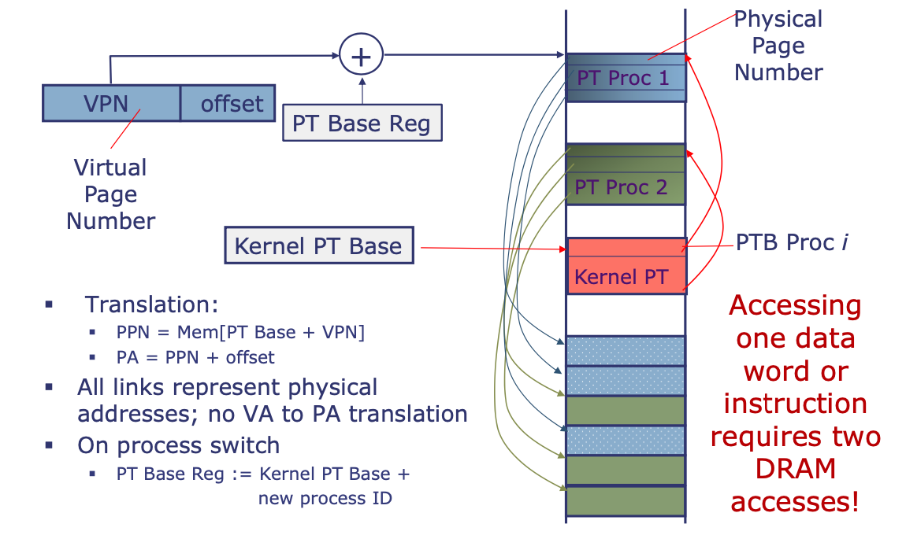
Kernel Page Table for all processes
Kernel Page Table contains entries for each processes
Kernel Page Table is managed by OS
Kernel Page Table also resides in Physical Memory

Slide 45
Summary
User program view:
Contiguous memory
Start from some set VA
“Infinitely” large
Is the only running program
Reality:
Non-contiguous memory
Start wherever available memory is
Finite size
Many programs running simultaneously
Virtual memory provides:
Illusion of contiguous memory
All programs starting at same set address
Illusion of ~ infinite memory (2³² or 2⁶⁴ bytes)
Protection
Implementation:
Divide memory into chunks (pages)
OS controls page table that maps virtual into physical addresses
memory as a cache for disk

Slide 46
Backup

Slide 47
Swap Space
Swap-space — Virtual memory uses disk space as an extension of main memory
Less common now due to memory capacity increases
The OS creates the space on disk for all the pages of a process when it creates the process.
This disk space is called the swap space.
OS also creates a data structure to record where each virtual page is stored on disk

Slide 48
The Problem
Physical memory is of limited size (cost)
What if you need more?
Should the programmer be concerned about the size of code/data blocks fitting physical memory?
Should the programmer manage data movement from disk to physical memory?
Should the programmer ensure two processes (different programs) do not use the same physical memory?
Also, ISA can have an address space greater than the physical memory size
E.g., a 64-bit address space with byte addressability
What if you do not have enough physical memory?

Slide 49
Main Memory (DRAM Cache) Organization
Main Memory (DRAM cache) organization driven by the enormous miss penalty
DRAM is about 10x slower than SRAM
Disk is about 10,000x slower than DRAM
Time to load block from disk > 1ms (> 1 million clock cycles)
CPU can do a lot of computation during that time
Consequences
Large page (block) size: typically 4 KB
Linux “huge pages” are 2 MB (default) to 1 GB
Fully associative
Any VP can be placed in any PP
Requires a “large” mapping function – different from cache memories
Highly sophisticated, expensive replacement algorithms
Too complicated and open-ended to be implemented in hardware
Write-back rather than write-through

Slide 50
Allocating Pages
Allocating a new page (VP 5) of virtual memory (disk)
May be as a result of malloc
Subsequent miss will bring it into memory
Physical memory
(DRAM)
Physical page
number or
disk address
Valid
VP 1
PP 0
PTE 0
0
null
VP 2
1
VP 7
VP 3
PP 3
1
1
0
0
Virtual memory
(disk)
0
PTE 7
1
VP 1
Memory resident
page table
(DRAM)
VP 2
VP 3
VP 4
VP 5
VP 6
VP 7
Adapted from Bryant and O’Hallaron, Computer Systems: A Programmer’s Perspective, Third Edition

Slide 51
Locality to the Rescue Again!
Virtual memory works because of locality
At any point in time, programs tend to access a set of active virtual pages called the working set
Programs with better temporal locality will have smaller working sets
If (working set size < main memory size)
Good performance for one process (after cold misses)
If (working set size > main memory size )
Thrashing: Performance meltdown where pages are swapped (copied) in and out continuously
If multiple processes run at the same time, thrashing occurs if their total working set size > main memory size

Slide 52
Virtual Memory: Responsibilities
Uses main memory efficiently
Give illusion of larger memory by storing some content on disk
Also allows OS to share memory across processes
Working set of “pages” reside in main memory - others reside on disk
Disk is usually much larger and slower than DRAM
Use “clever” caching strategies
Protection:
Isolates address spaces
One process can’t interfere with another’s memory
Protects processes from each other
User program cannot access privileged kernel information and code
Errors in one program won’t corrupt memory of other program
Adapted from Bryant and O’Hallaron, Computer Systems: A Programmer’s Perspective, Third Edition

Slide 53
Difficulties of Direct Physical Addressing
Programmer needs to manage physical memory space
Inconvenient and hard
Harder when you have multiple processes
Difficult to support code and data relocation
Addresses are directly specified in the program
Difficult to support multiple processes
Protection and isolation between multiple processes
Sharing of physical memory space
Difficult to support data/code sharing across processes

Slide 54
Abstraction: Virtual vs. Physical Memory
Programmer sees virtual memory
Can assume the memory is “infinite”
Reality: Physical memory size is much smaller than what the programmer assumes
The system (system software + hardware, cooperatively) maps virtual memory addresses to physical memory
The system automatically manages the physical memory space transparently to the programmer
+ Programmer does not need to know the physical size of memory nor manage it → A small physical memory can appear as a huge one to the programmer → Life is easier for the programmer
-- More complex system software and architecture

Slide 55
Physical Memory as a Cache
In other words…
Physical memory is a cache for pages stored on disk
In fact, it is a fully associative cache in modern systems (a virtual page can potentially be mapped to any physical frame)
Most accesses hit in the physical memory at the speed of DRAM, yet the program enjoys the capacity of the larger virtual memory
Similar caching issues exist as we have covered earlier:
Placement: where and how to place/find a page in cache?
Replacement: what page to remove to make room in cache?
Granularity of management: large, small, uniform pages?
Write policy: what do we do about writes? Write back?

Slide 56
Cache/Virtual Memory Analogues
Cache | Virtual Memory
Block | Page
Block Size | Page Size
Block Offset | Page Offset
Miss | Page Fault
Tag | Virtual Page Number

Slide 57
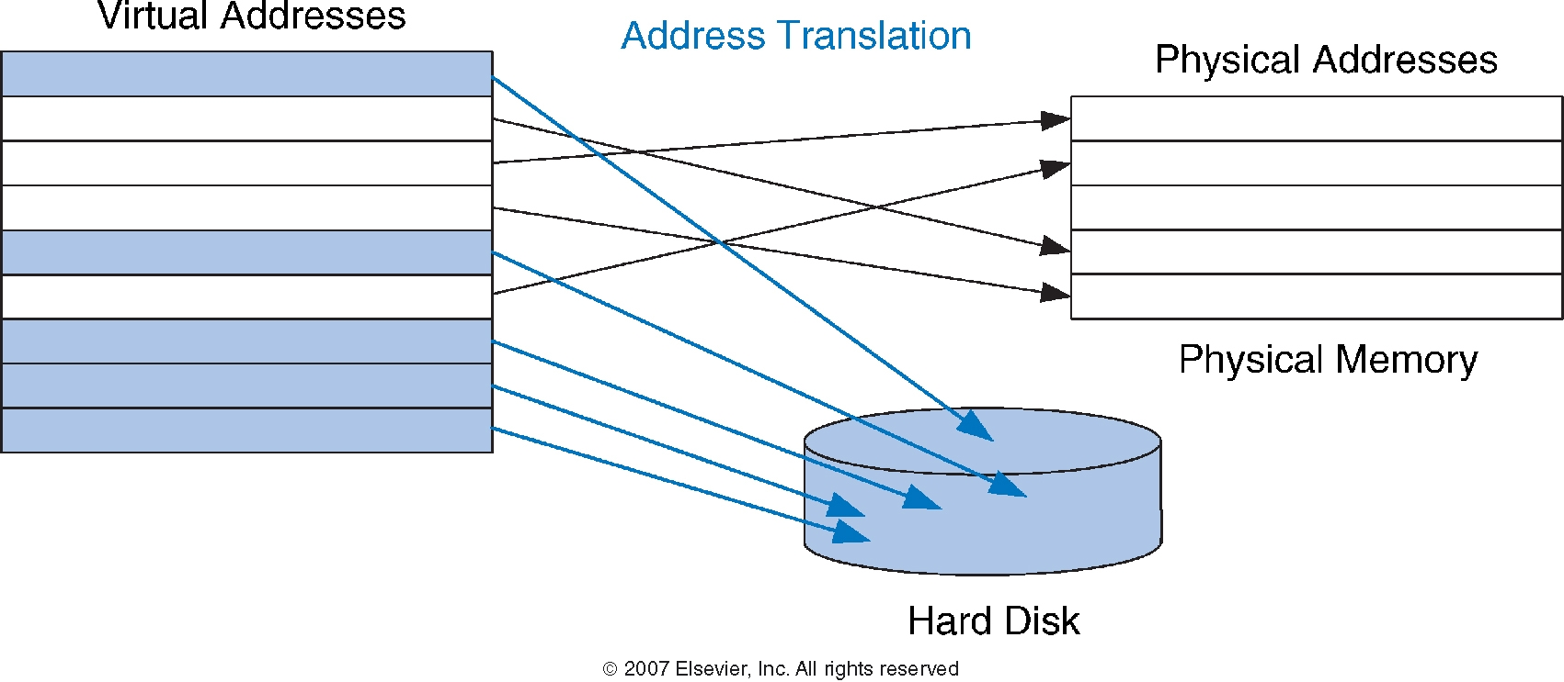
Virtual and Physical Addresses
Most accesses hit in physical memory
But programs see the large capacity of virtual memory

Slide 58
Supporting Virtual Memory
Virtual memory requires both HW+SW support
Page Table is in memory
Can be cached in special hardware structures called Translation Lookaside Buffers (TLBs)
The hardware component is called the MMU (memory management unit)
Includes Page Table Base Register(s), TLBs, page walkers
It is the job of the software to leverage the MMU to
Populate page tables, decide what to replace in physical memory
Change the Page Table Register on context switch (to use the running thread’s page table)
Handle page faults and ensure correct mapping

Slide 59
Some System Software Jobs for VM
Keeping track of which physical frames are free
Allocating free physical frames to virtual pages
Page replacement policy
When no physical frame is free, what should be swapped out?
Sharing pages between processes
Copy-on-write optimization
Page-flip optimization

